Slide 1
THE HEAVEN BELOW
Development Log
Bruno Mirone BA (Hons) Game Design, Level 4, UCA
Built in Unreal Engine 5.6 using Blueprints only
Notes:
Solo project. Blueprint only, no C++.

Slide 2
The game
A 2.5D descent platformer. Humanity built towers to reach heaven, found nothing there, and now digs downward instead. You play a Diver going down through the ruins.
22
0
6
3
assets
lines of code
landings
Echoes
Player
Pressure
Moves along one axis, jumps, slides, attacks and grabs ledges.
Oxygen drains constantly and only air pockets and checkpoints refill it.
Descent
Loop
Six landings alternate left and right, each one drop below the last.
Explore, avoid hazards, collect Echoes and reach the tool at the bottom.

Slide 3
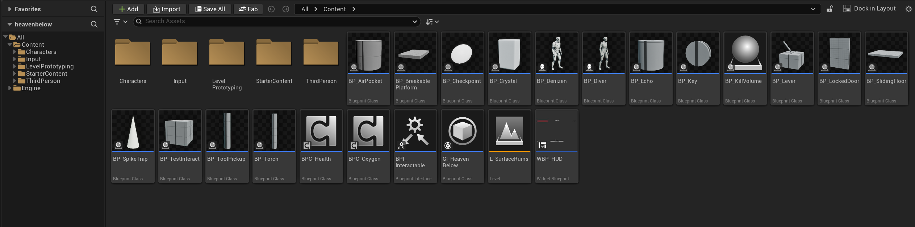
Everything in the project
Twenty two assets in total: sixteen actors, two shared components, one interface, a Game Instance, one widget and one level.
Content Browser

Slide 4
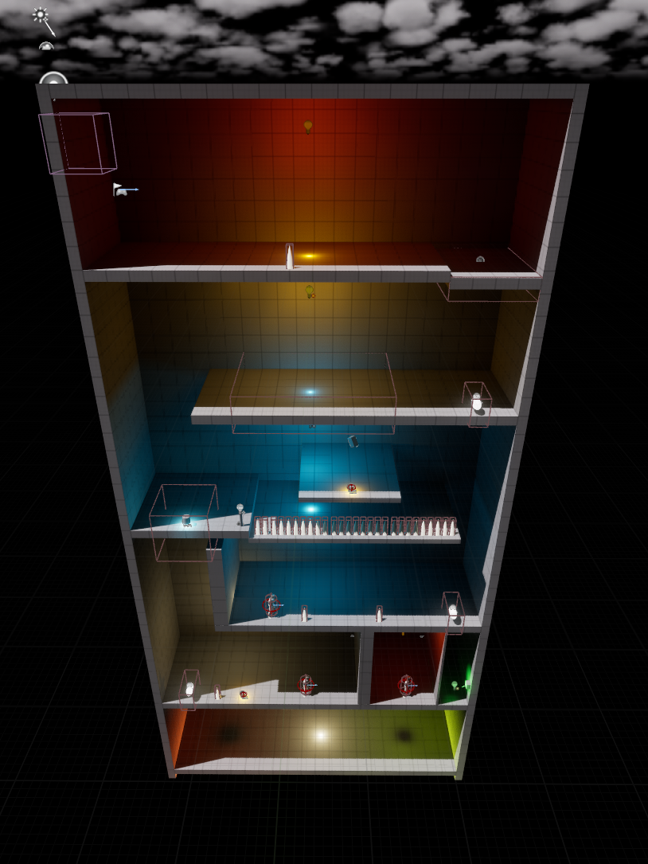
The level
Level 1 is one enclosed vertical shaft with six landings that alternate left and right, so all progress is downward and there is no way back up.
L0
Spike trap, then a breakable platform that drops you in
L1
Checkpoint, air pocket and a sliding floor you must slide across
L2
Torch and crystal reveal the bridge to the first Echo
L3
The Denizen drops the key for the locked door
L4
Spike trap, the second Echo, and a lever that opens the way down
L5
Air pocket, the last Echo and the tool that ends the level
L_SurfaceRuins, seen from outside

Slide 5
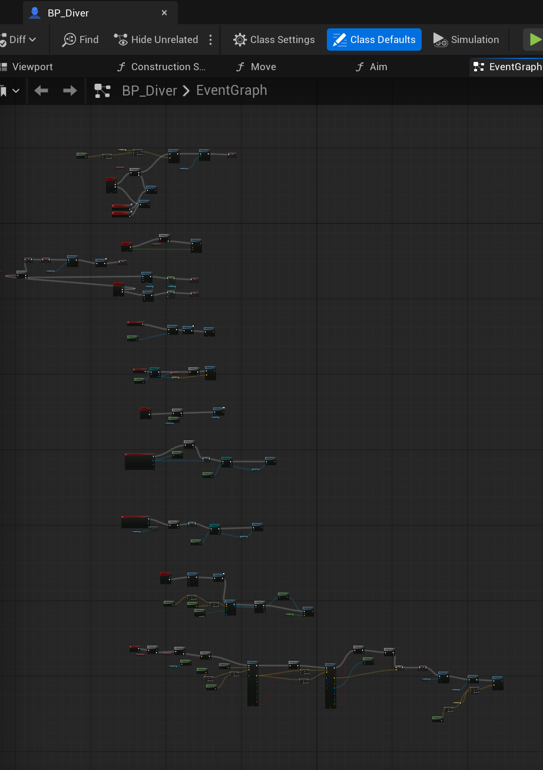
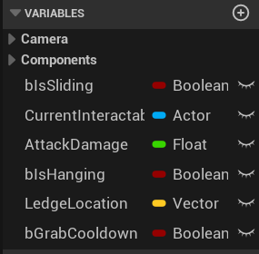
The player
One Blueprint holds every player system, and every value the design needs to tune lives on it as a variable.
BP_Diver, Event Graph
BP_Diver, variables

Slide 6
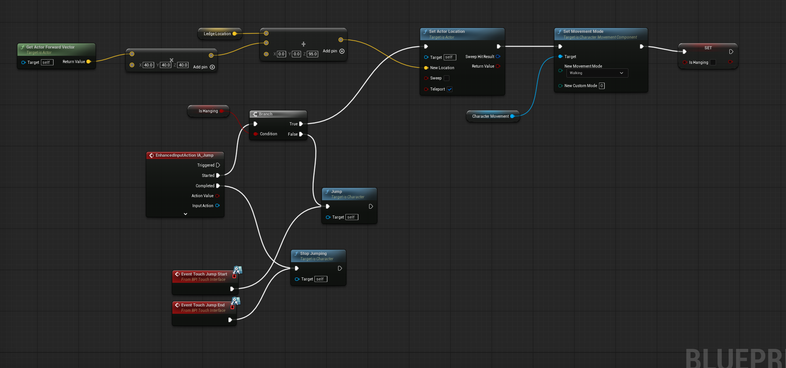
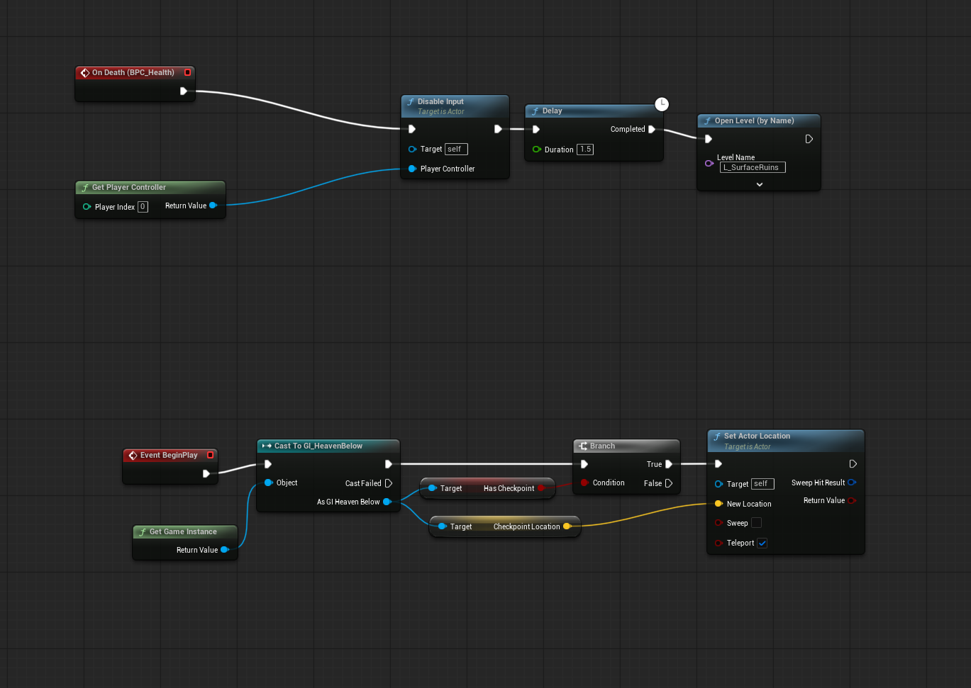
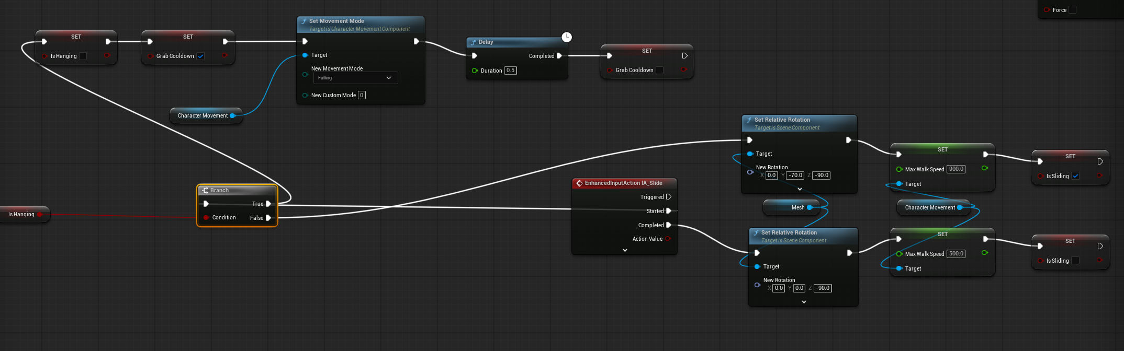
Jumping, sliding and dying
Jump either pulls the Diver up a held ledge or jumps normally, sliding tilts the mesh and raises walk speed, and death disables input then reloads the level at the last checkpoint.
BP_Diver, jump and mantle
BP_Diver, slide
BP_Diver, death and respawn

Slide 7
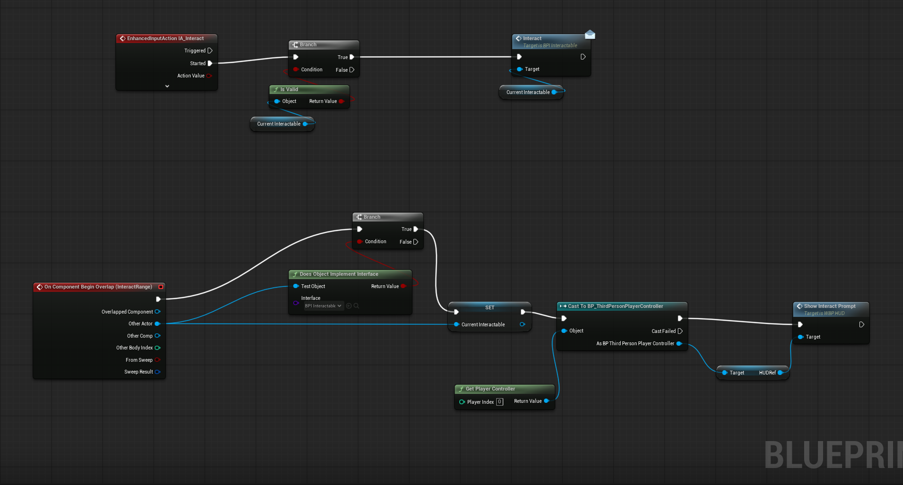
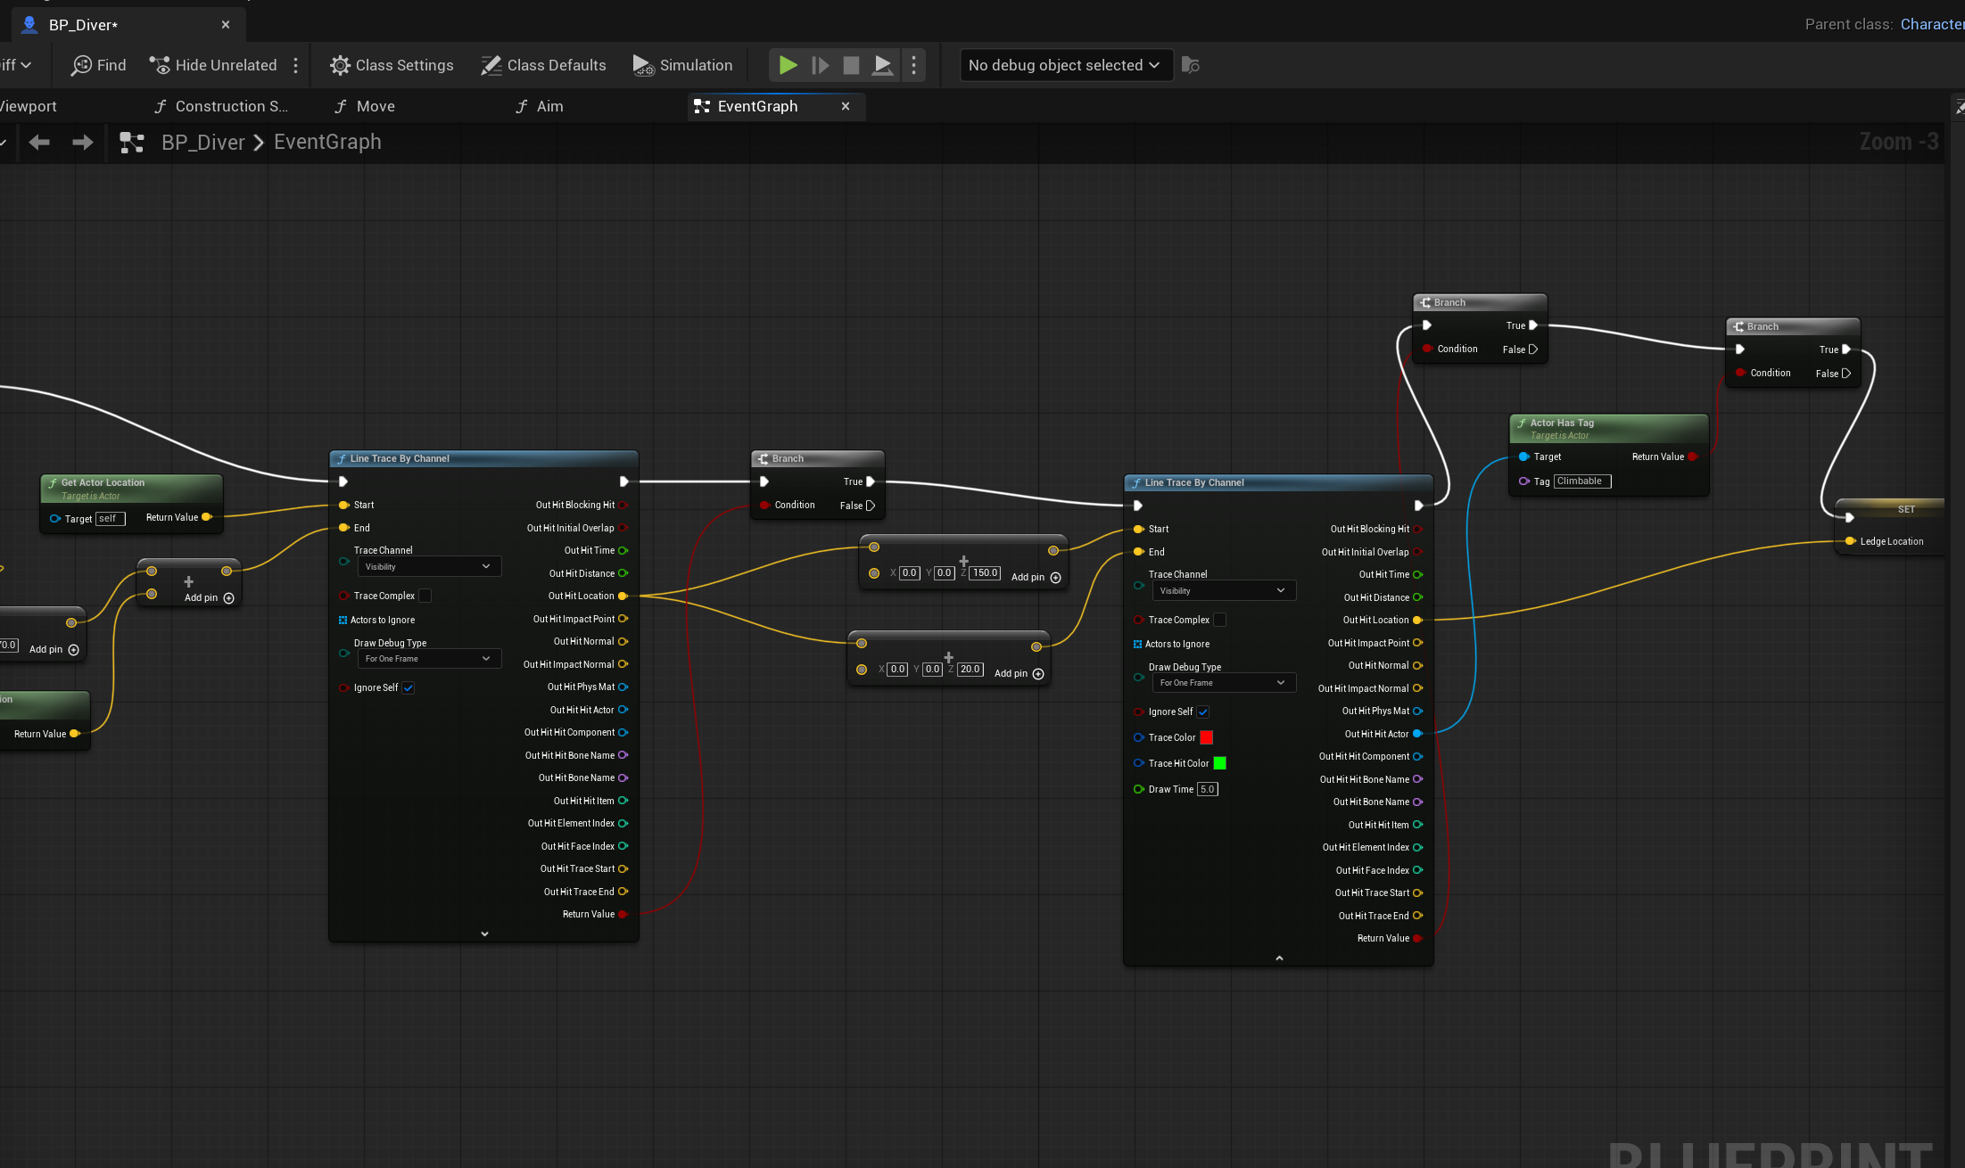
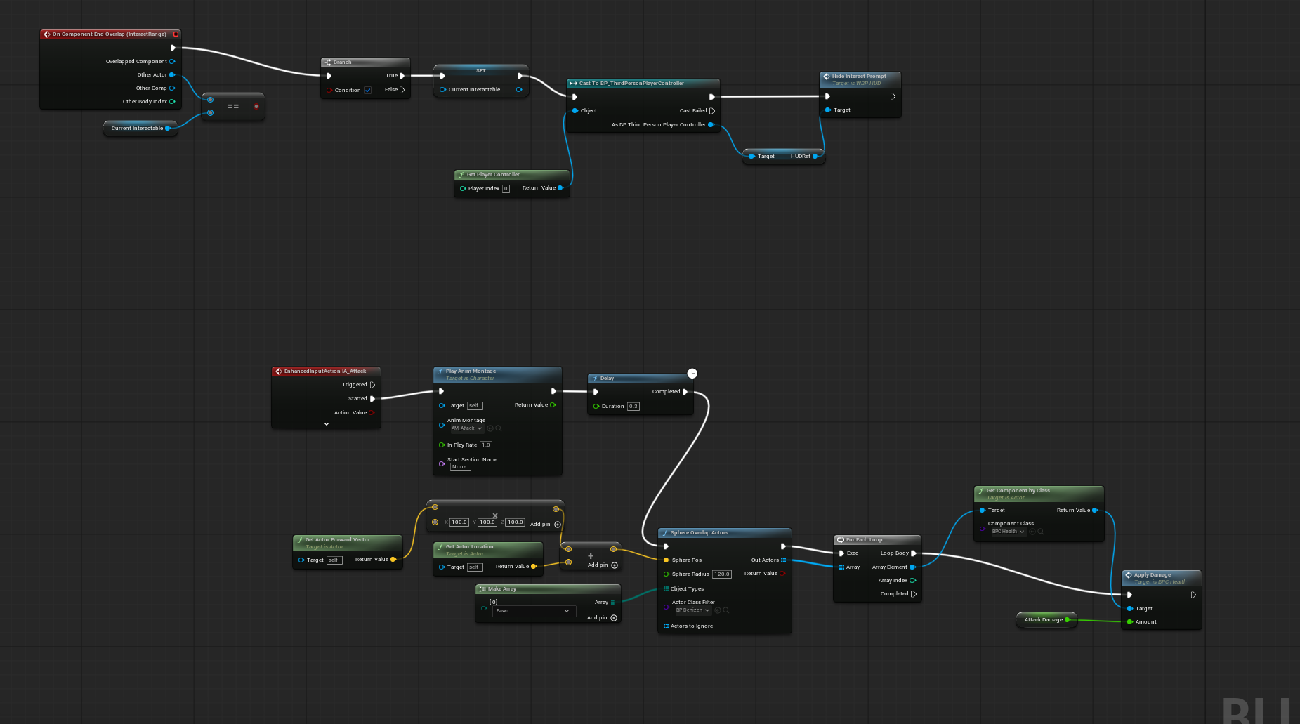
Interacting, attacking and climbing
A sphere on the Diver watches for anything that implements the interact interface, the attack sweeps for Denizens in front of the player, and two line traces look for a ledge to grab while falling.
BP_Diver, interact
BP_Diver, attack
BP_Diver, ledge detection

Slide 8
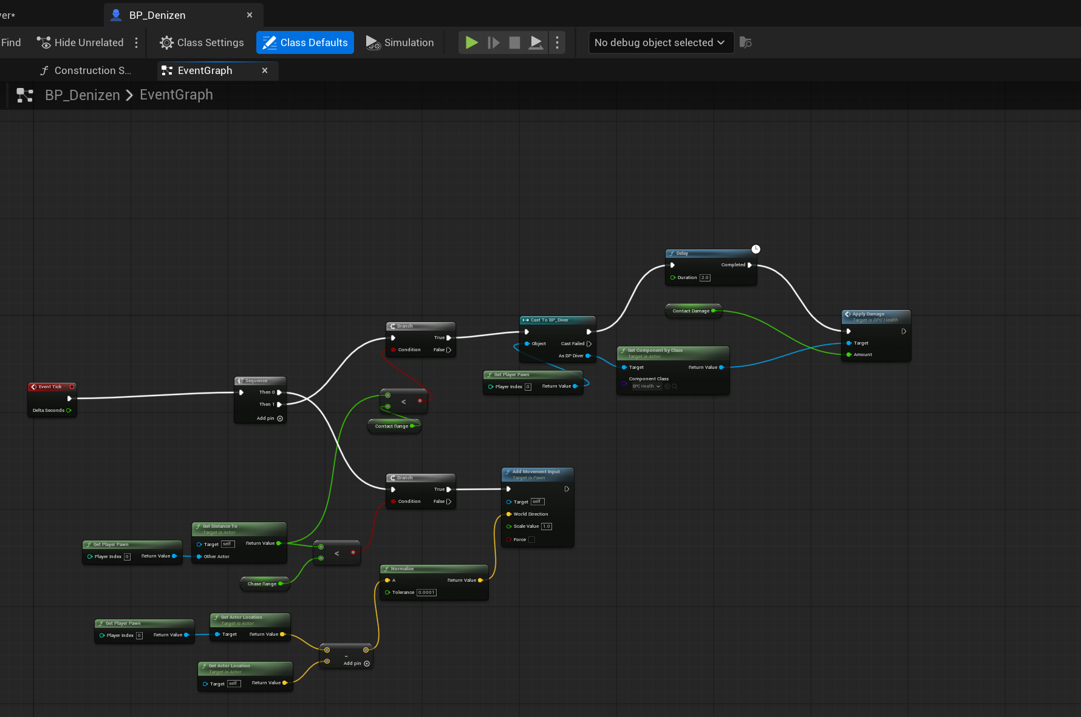
The Denizen
The Denizen measures its distance to the player every frame and either walks toward them or damages them on contact with a two second cooldown.
BP_Denizen, Event Graph

Slide 9
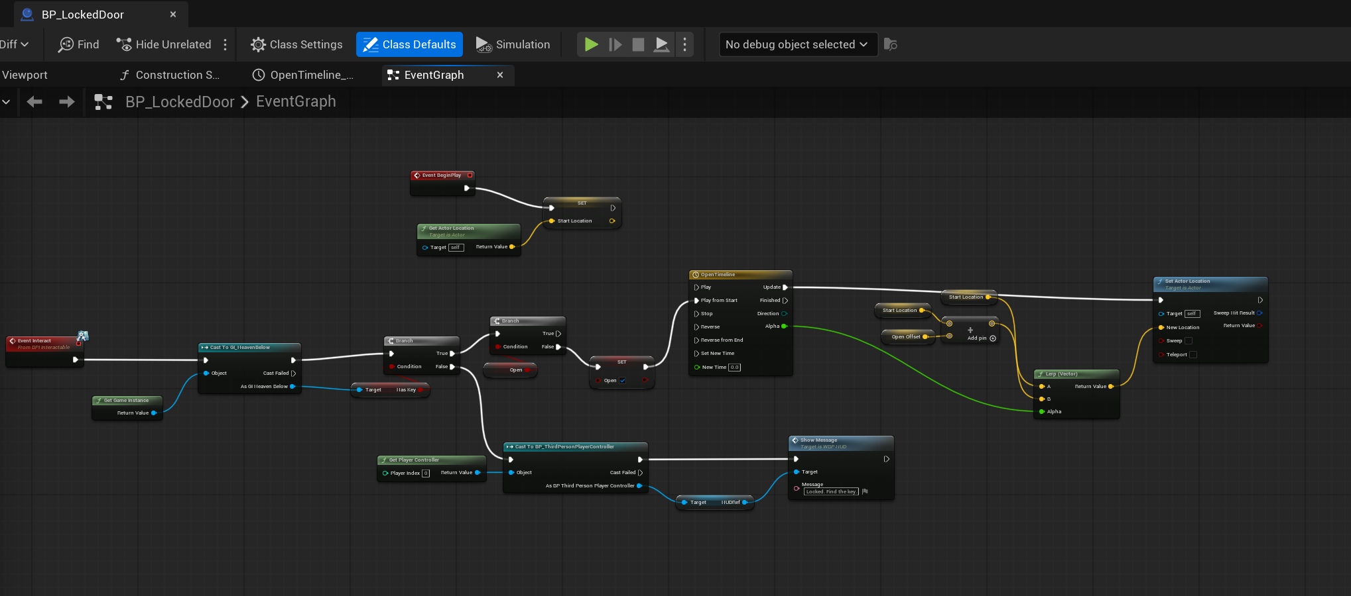
The locked door
The door checks the Game Instance for the key and either opens on a Timeline or tells the player through the HUD that it is still locked.
BP_LockedDoor, Event Graph

Slide 10
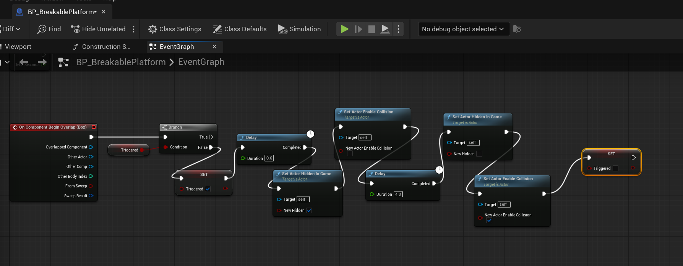
The breakable platform
Standing on it starts a short delay, then it hides itself and drops its collision, and four seconds later it returns so the level can be replayed.
BP_BreakablePlatform, Event Graph

Slide 11
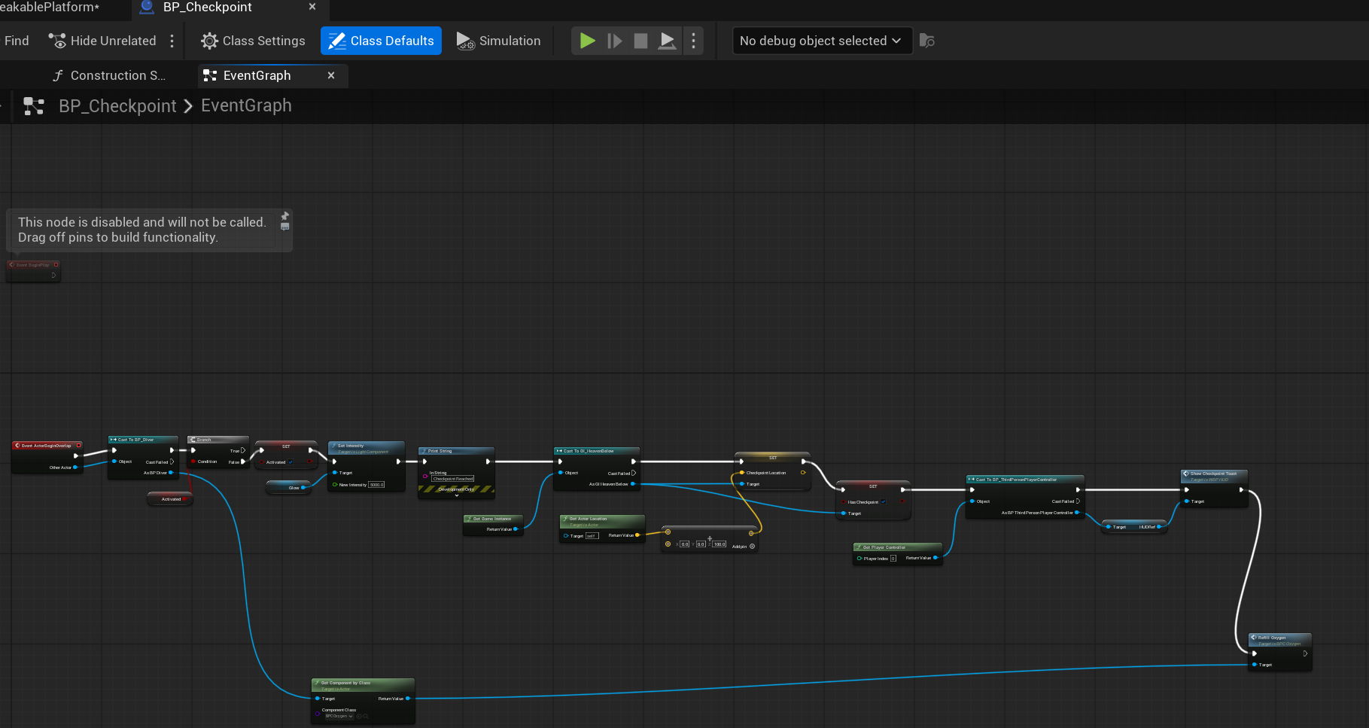
Checkpoints
Touching a checkpoint lights it, stores the location on the Game Instance so it survives a level reload, refills oxygen and shows a toast on the HUD.
BP_Checkpoint, Event Graph

Slide 12
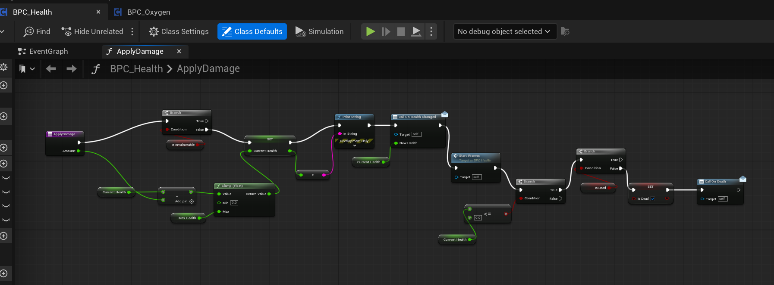
Shared health
One reusable component handles damage for the Diver and the Denizen, clamping health, granting a second of invulnerability and firing death only once.
BPC_Health, ApplyDamage

Slide 13
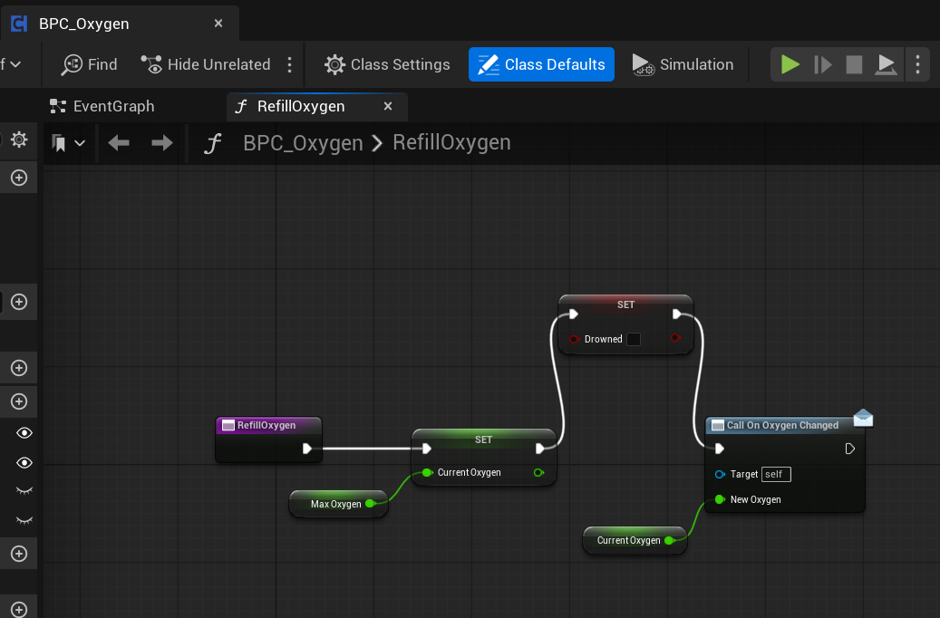
Oxygen
Oxygen drains on a timer and is the real clock on the level, so refilling it resets the value, clears the drowned flag and updates the HUD.
BPC_Oxygen, RefillOxygen

Slide 14
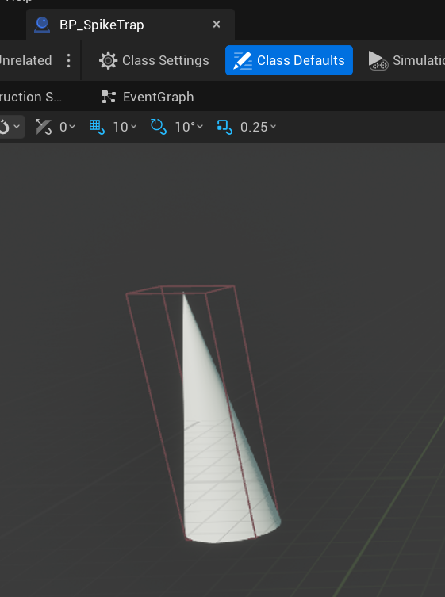
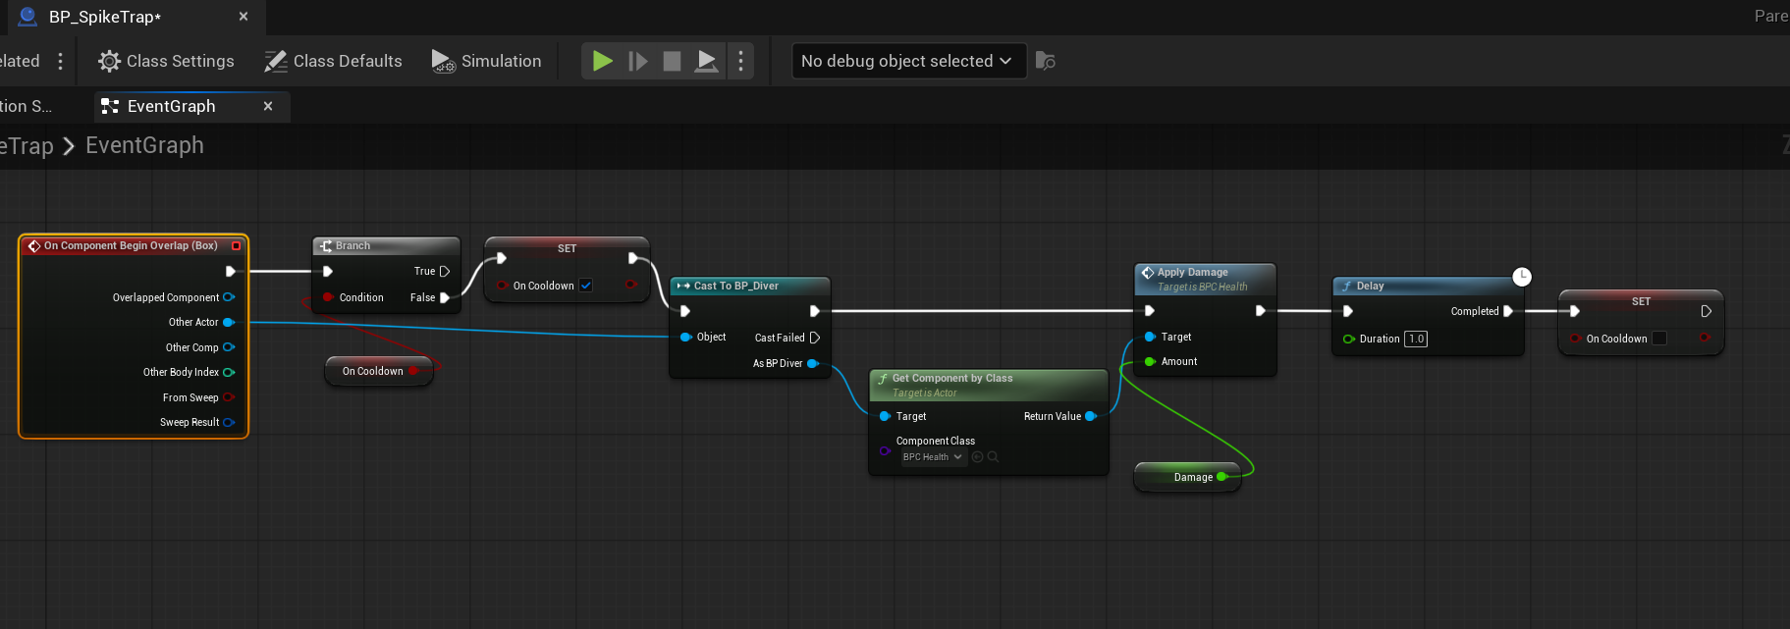
The spike trap
The trigger box is deliberately larger than the spike mesh so the hazard is not missed at running speed, and a one second cooldown stops it draining health every frame.
BP_SpikeTrap, viewport
BP_SpikeTrap, Event Graph

Slide 15
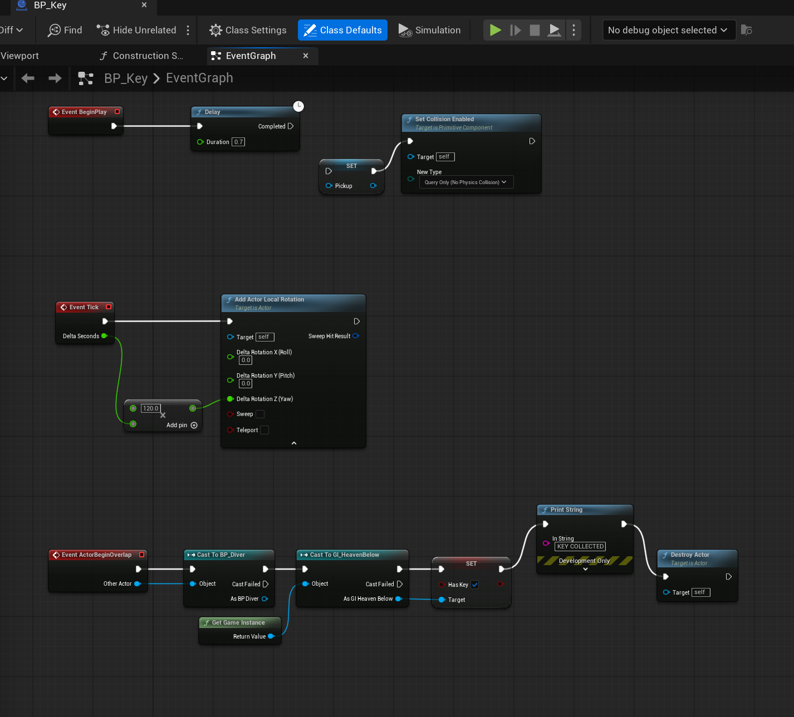
The key
The key spins to draw the eye, arms its pickup collision after a short delay so it cannot be collected inside the Denizen, and records itself on the Game Instance.
BP_Key, Event Graph

Slide 16
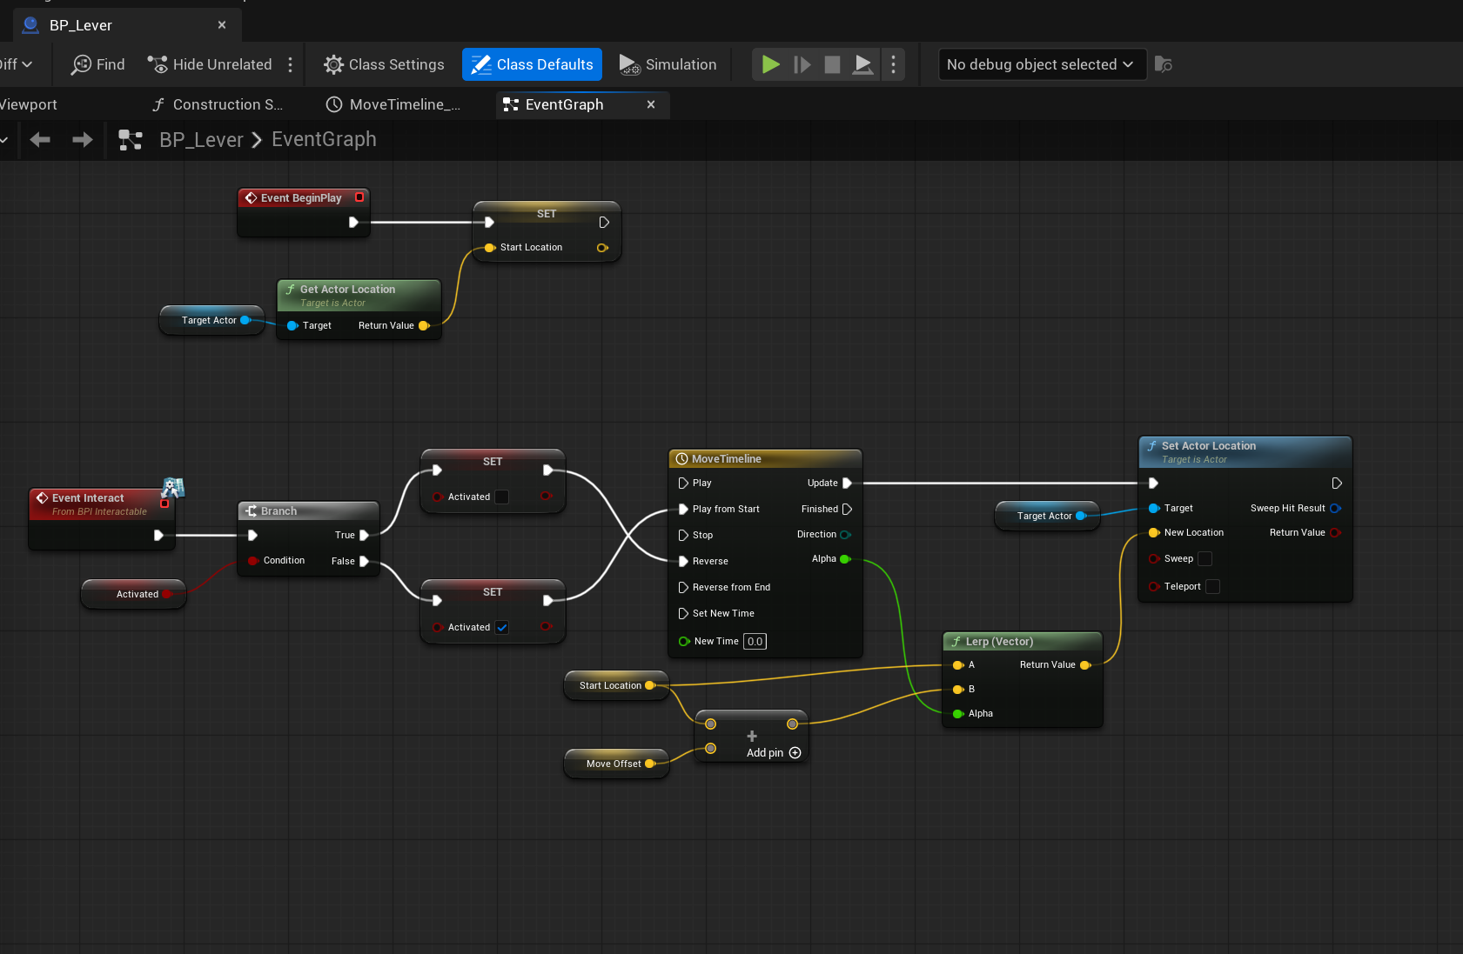
The lever
The lever stores its target's starting position on begin play, then drives a Timeline that moves that actor by an offset set on each copy.
BP_Lever, Event Graph

Slide 17
What I learned
Scope honestly
Components beat copies
The design document describes five biomes and a boss. I built one biome and recorded every cut and the reason for it rather than pretending the rest was still coming.
Writing health once as a component meant the Diver and the Denizen shared it, so adding a second damageable actor cost minutes instead of hours.
Geometry can lie
Read the asset, not the symptom
An engine cube ships with a collision box over three times the size of its mesh. It read as floating above floors and stopping short of walls until I compared the two numbers directly.
Most of my worst bugs produced no error at all. Checking the values actually stored in the asset found in minutes what guessing had not found in hours.

